Slide 1
Object Oriented Programming using Java (ECSE102L)

Slide 2
Outline
Conditional Statements

Slide 3
Conditional Statements
S
A conditional statement allows us to choose which statement will be executed. So, it is sometimes called as selection statement.
Conditional statement gives us the power to make decision.
Java has the following conditional statements:
  If
  if-else
  nested-if
  if-else-if
  switch-case
  jump – break, continue, return

Slide 4
if Statement
S
if statement is the most simple decision making statement.
It is used to decide whether a certain statement or block of statements will be executed.
Syntax:
if(condition)
{
Statement 1;
Statement 2;
}

Slide 5
if Statement (Cont…)
S
if is a Java reserved word.
The condition must be a Boolean expression. It must evaluate to either true or false.
If we do not give the curly braces ‘{’ and ‘}’ after if(condition), then, by default if statement considers the immediate statement inside its block. Example:
if(condition)
statement 1; //Statement 1 will be executed
statement 2;

Slide 6
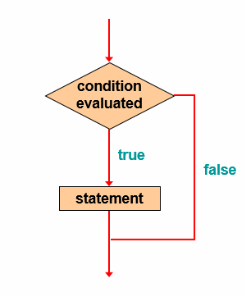
if Statement (Cont…)
S

Slide 7
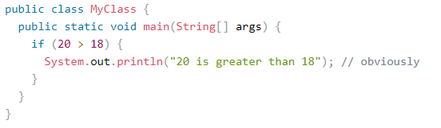
if Statement (Cont…)
S

Slide 8
if Statement (Cont…)
S
Output
20 is greater than 18

Slide 9
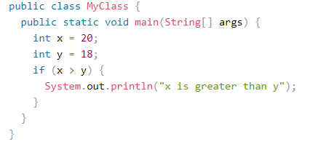
if Statement (Cont…)
S

Slide 10
if Statement (Cont…)
S
Output
x is greater than y

Slide 11
else Statement
S
Use the else statement to specify a block of code to be executed, if the condition is false.
Syntax:
if(condition)
{
Statement 1; // block of code to be executed, if the condition is true
}
else
{
Statement 2; // block of code to be executed, if the condition is false
}

Slide 12
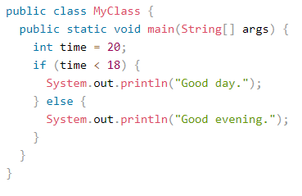
else Statement (Cont…)
S

Slide 13
else Statement (Cont…)
S
Output
Good evening.

Slide 14
else-if Statement
S
Use the else if statement to specify a new condition if the first condition is false.
Syntax:
if(condition1)
{
Statement 1; // block of code to be executed, if the condition1 is true
}
else if (condition 2)
{
Statement 2; // block of code to be executed, if the condition1 is false and condition2 is true
}
else
{
Statement 3; // block of code to be executed, if the condition1 is false and condition2 is false
}

Slide 15
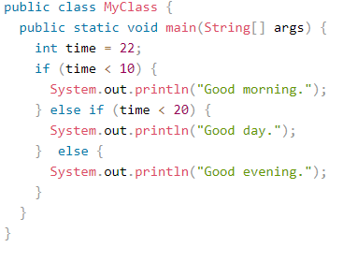
else-if Statement (Cont…)
S

Slide 16
else-if Statement (Cont…)
S
Output
Good evening.

Slide 17
Switch Statement
S
The switch statement is a multi-way branch statement.
It provides an easy way to dispatch execution to different parts of code based on the value of the expression.
The switch expression is evaluated once.
The value of the expression is compared with the values of each case.
If there is a match, the associated block of code is executed.
The break and default keywords are optional.

Slide 18
Switch Statement (Cont…)
S
Syntax:
switch(expression)
{
case x:
Statement 1; // code block
break;
case y:
Statement 2; // code block
break;
default:
Statement 3; // code block
}

Slide 19
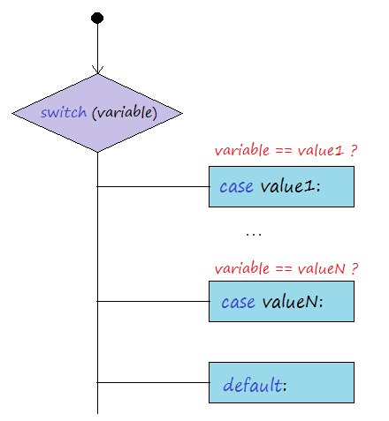
Switch Statement (Cont…)
S

Slide 20
Switch Statement (Cont…)
S
Break Keyword
  When Java reaches a break keyword, it breaks out of the switch block.
  This will stop the execution of more code and case testing inside the block.
  When a match is found, and the job is done, it's time for a break.
  There is no need for more testing.

Slide 21
Switch Statement (Cont…)
S
Default Keyword
  The default keyword specifies some code to run, if there is no case match.

Slide 22
Switch Statement (Cont…)
S
Some important rule:
  Duplicate case values are not allowed.
  The value for a case must be of the same data type as the variable in the switch.
  The value for a case must be a constant or a literal. Variables are not allowed.
  The break statement is used inside the switch to terminate a statement sequence.
  The break statement is optional. If omitted, execution will continue on into the next case.
  The default statement is optional and can appear anywhere inside the switch block. In case, if it is not at the end, then, a break statement must be kept after the default statement to omit the execution of the next case statement.

Slide 23
Switch Statement (Cont…)
S
public class MyClass {
public static void main(String[] args)
{
int day = 4;
switch (day)
{
case 1:
System.out.println("Monday");
break;
case 2:
System.out.println("Wednesday");
break;
case 3:
System.out.println("Thursday");
break;
case 4:
System.out.println("Friday");
break;
case 5:
System.out.println("Saturday");
break;
case 6:
System.out.println("Sunday");
break;
}
} }

Slide 24
Switch Statement (Cont…)
S
Output
Friday

Slide 25
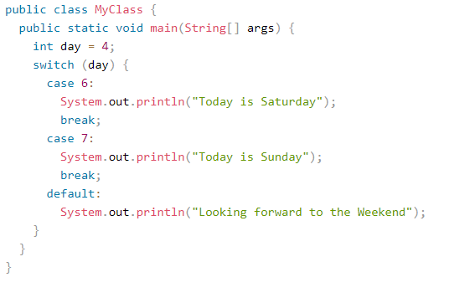
Switch Statement (Cont…)
S

Slide 26
Switch Statement (Cont…)
S
Output
Looking forward to the Weekend

Slide 27




